Slide 1
Door Access
Control System
Team 2 - Large Spearfish

Slide 2
Team Members
Jaeden Carpenter
Undergraduate Student: Electrical Computer Engineering
Zijian Liu
Graduate Student: Industrial Engineering
Zari Malbacias
Graduate Student (online): Engineering Management

Slide 3
Introduction

Slide 4
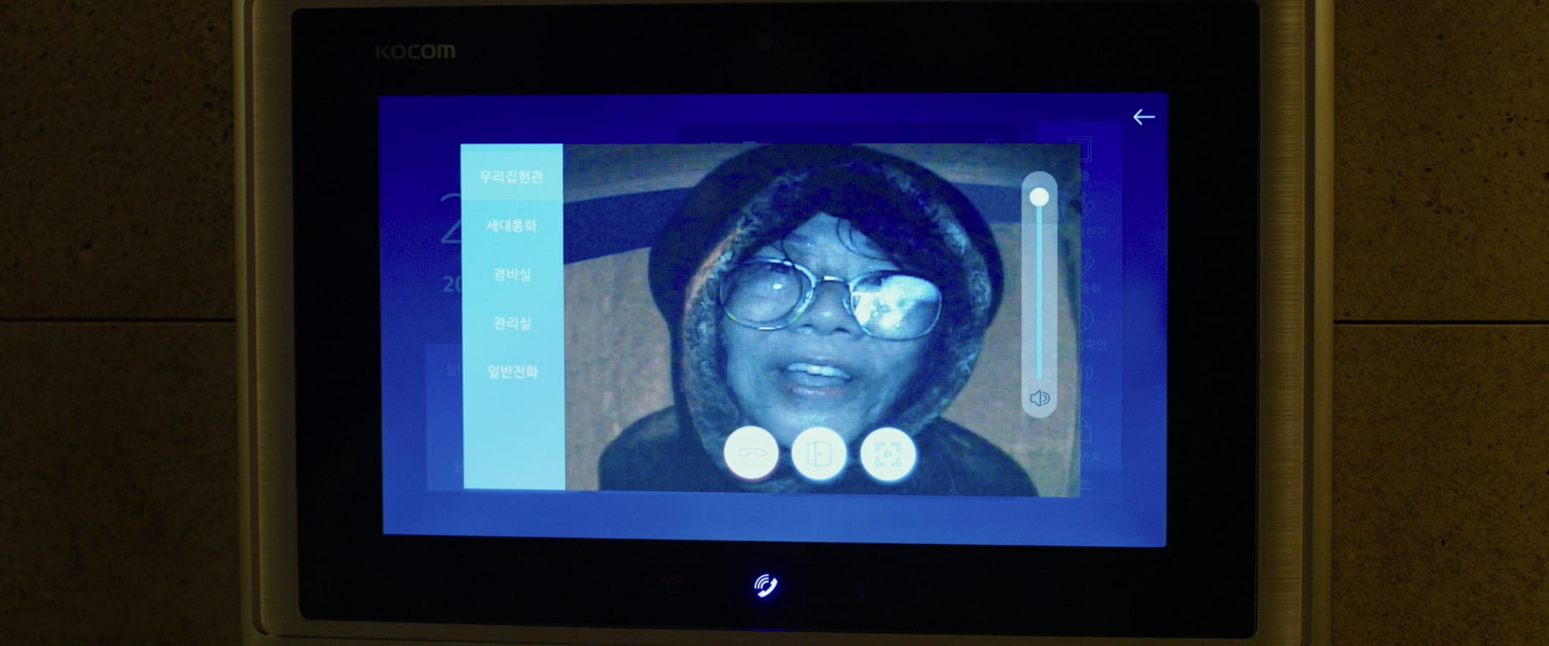
Introduction
Door Access Control Systems
Researching various types of systems
Exploring vulnerabilities
Popularity With Similar Systems
Almost every house and building has a security system
Technology has increased to help protect homes and buildings
Team Project
Red Team Simulation
Analyzing threats and developing countermeasures
Thorough system assessment

Slide 5
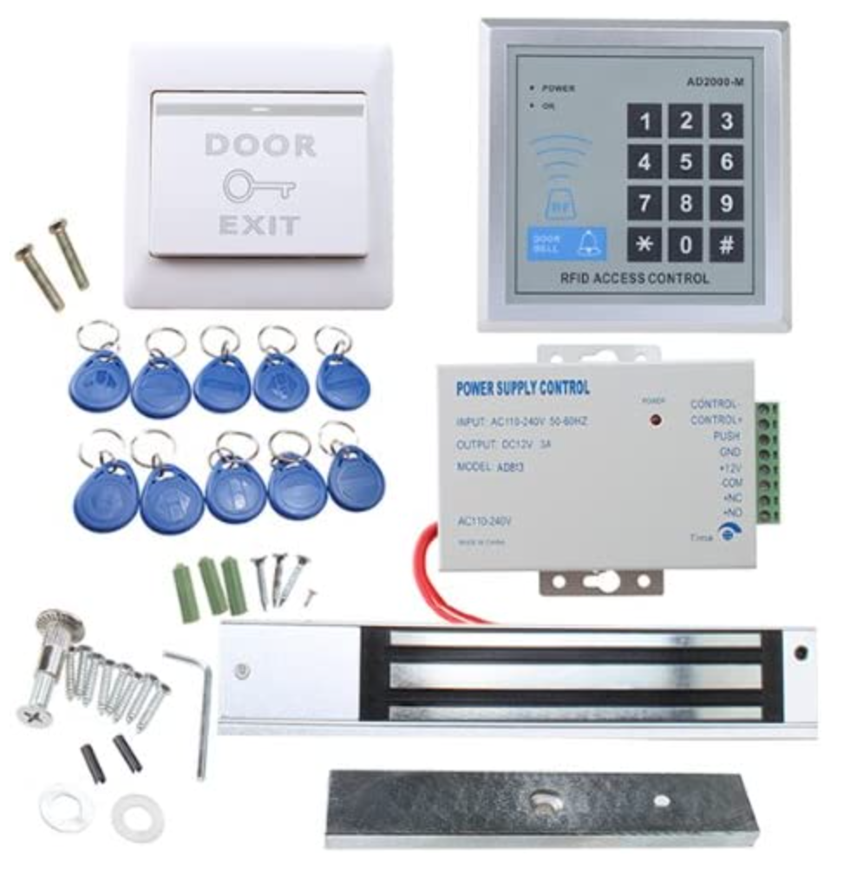
Door Access Control System
Manufacturer: AGPTEK
An RFID proximity door access control system
Access includes using proximity cards, passwords, or mix of both
Connects to power
Connection protected by CPU and integrated circuit
Main components:
RFID Proximity Door Entry Pad
Power Supply
Electronic Magnetic Lock
Push Release Button

Slide 6
System Specifications
No. | Item | Specifications
1 | Working power | AC:110-240V 50-60Hz
2 | Unlocking relay | DC12V/2A
3 | Ambient temperature | Working: 0℃~45℃ Storage: -10℃~55℃
4 | Relative humidity | Working: 40%~90%RH Storage: 20%~90%RH
5 | Number of cards allowed | 1000
6 | Proximity card recognition frequency | ID type: 125KHz
7 | Proximity card recognition | ID type: EM or EM compatible cards
8 | Car reading distance | ID type: 5~15 cm
9 | Electric lock interface | Output from the relay or the level (optional)
10 | External card reader interface | A Wiegand26 interface
11 | Ways of opening the door | Door card or the unlocking password
12 | Unlocking duration | 3 seconds
13 | Tamper alarm | Activated

Slide 7
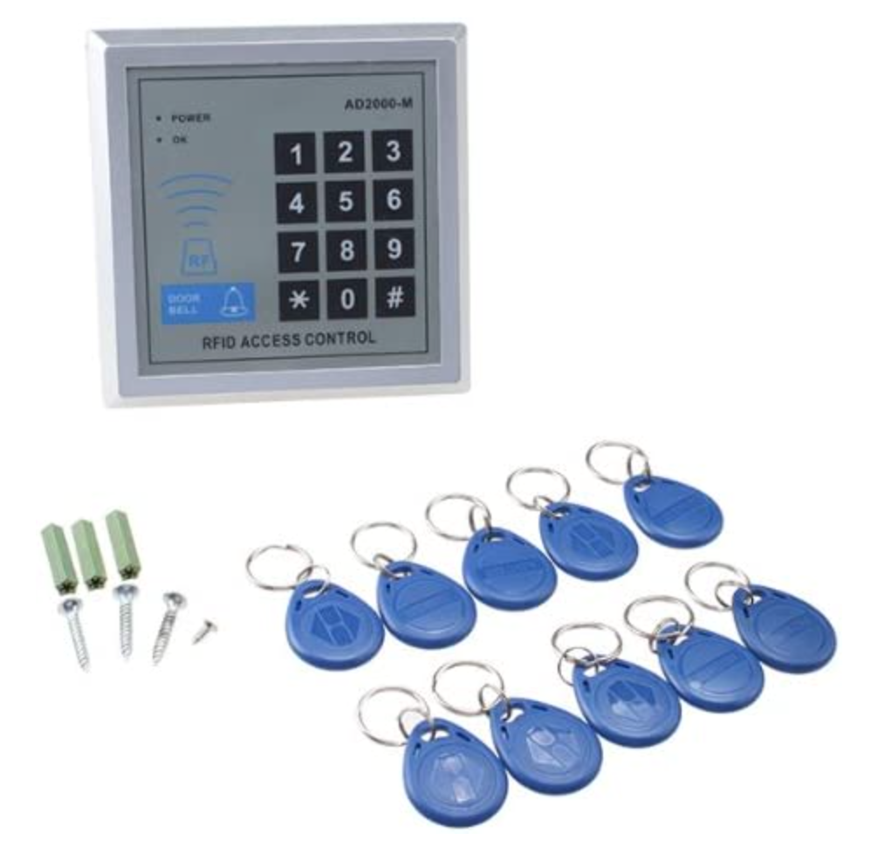
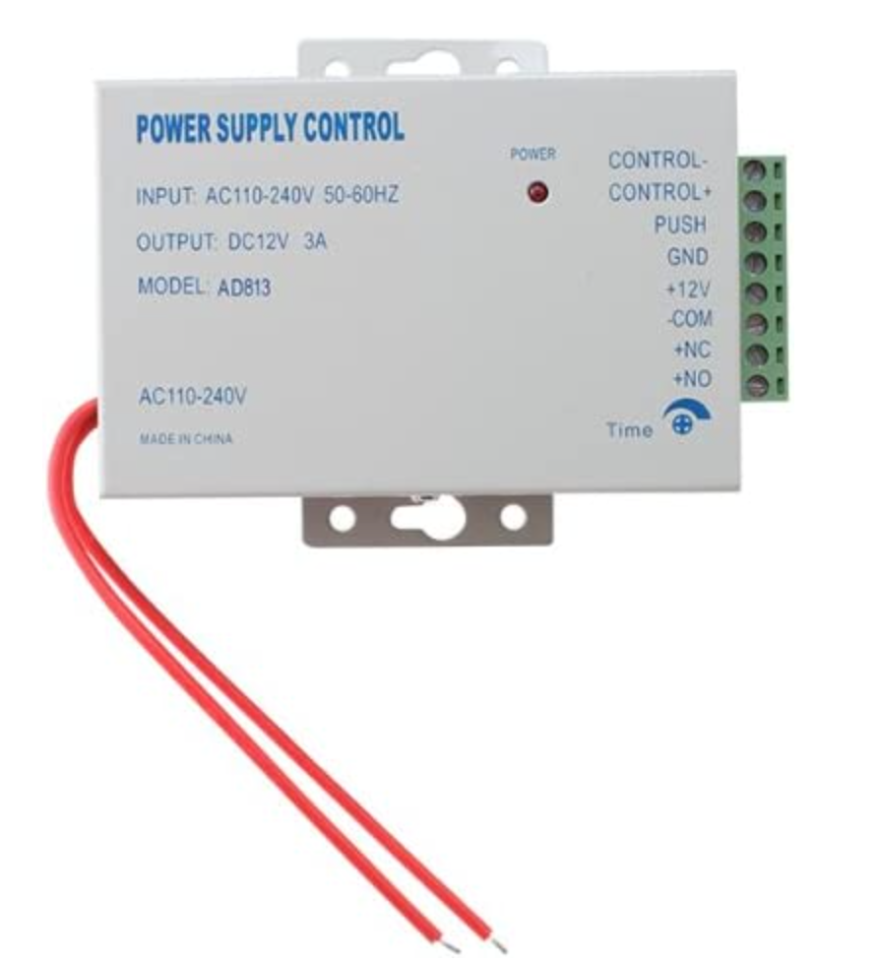
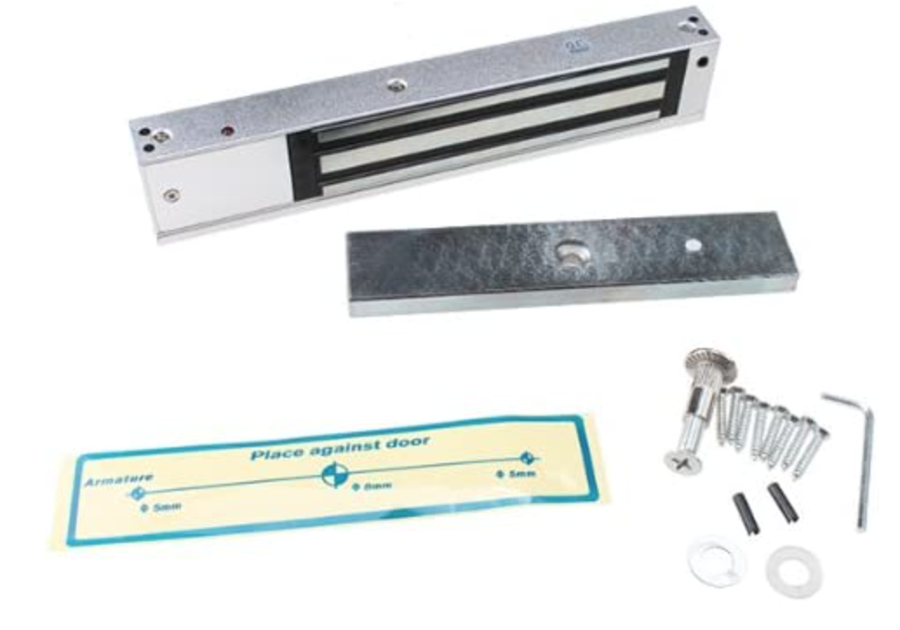
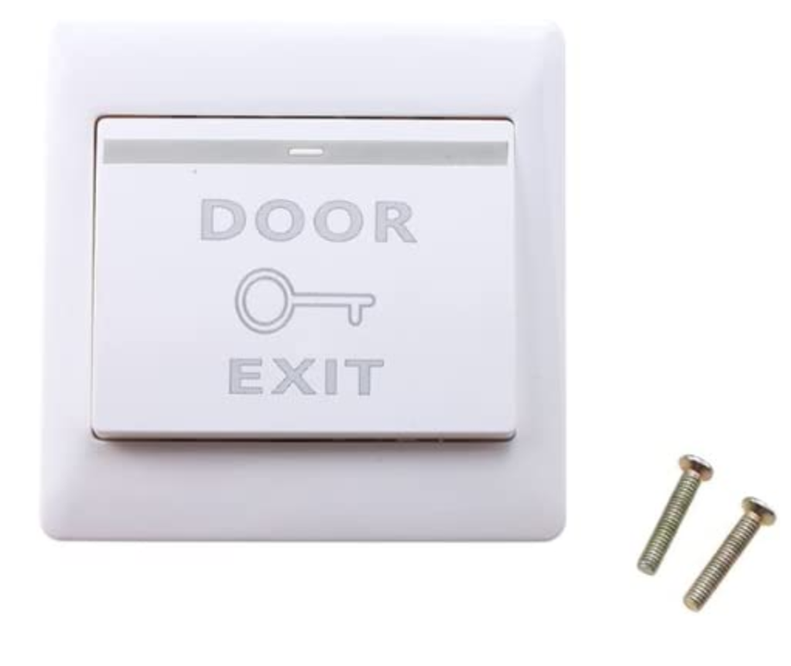
Main Components
RFID Proximity Door Entry Pad
Power Supply
Electric Magnetic Lock
Push Release Button

Slide 8
System Architecture

Slide 9
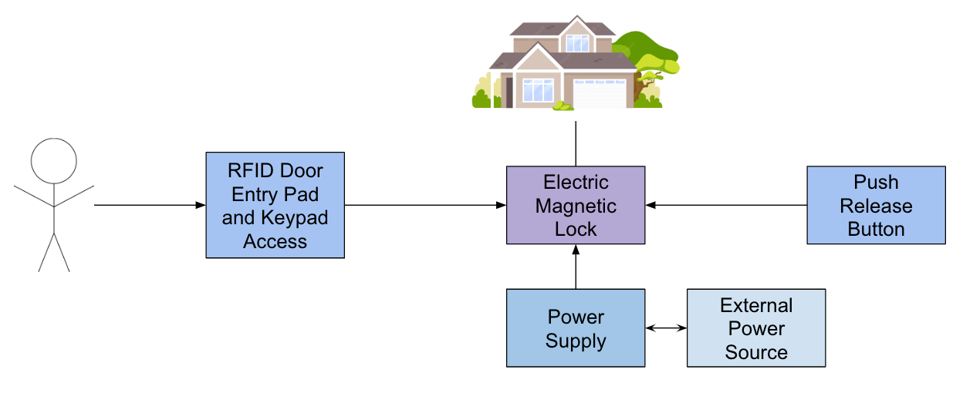
System Architecture

Slide 10
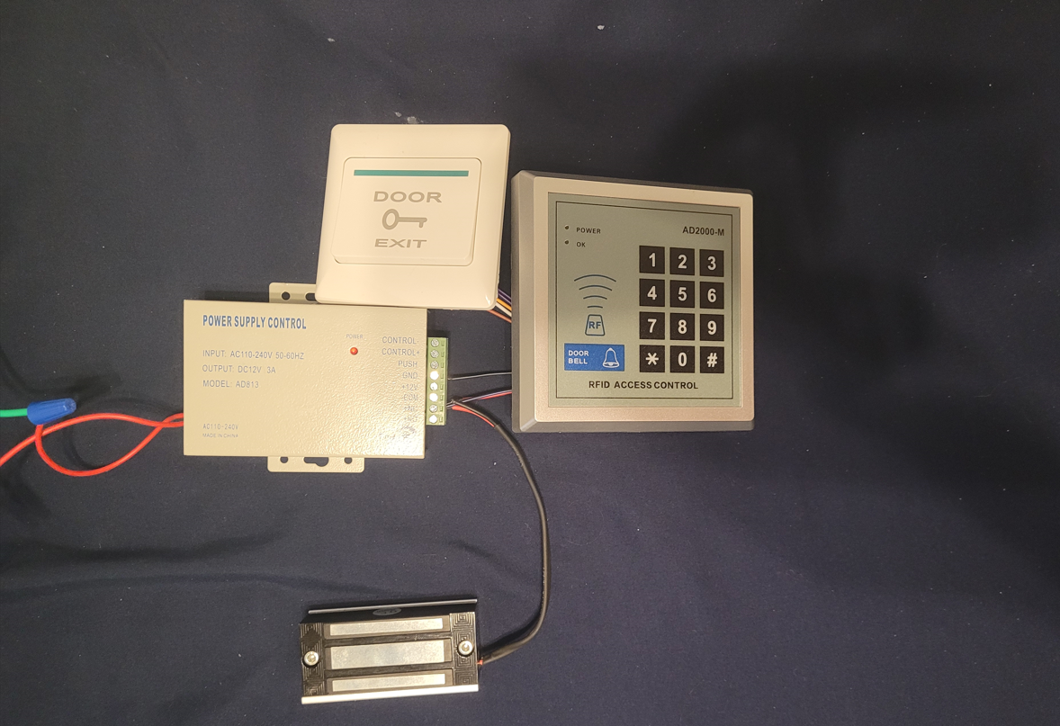
Access Control System
Push Release Button
Entry Pad
Power Supply
Cables to Power Source
Electric Magnetic Lock

Slide 11
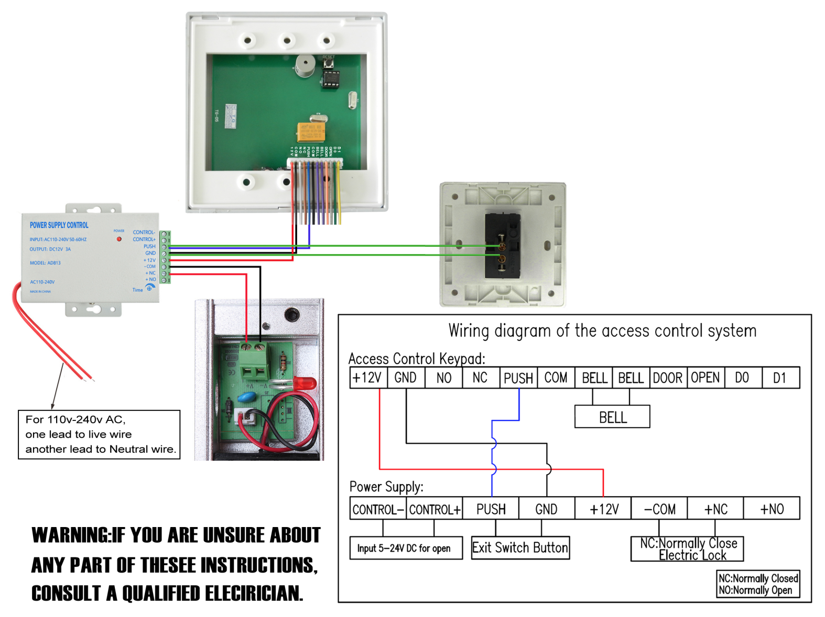
Wiring Diagram

Slide 12
Threat Model

Slide 13
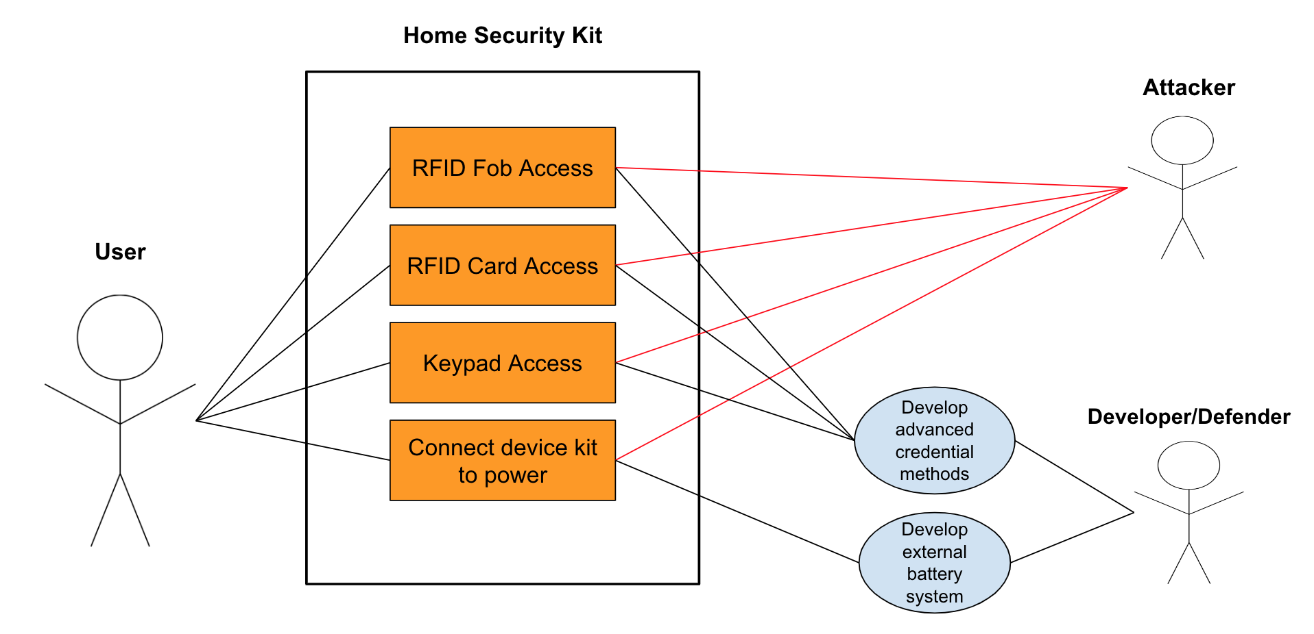
Use Cases

Slide 14

System Threats and Vulnerabilities
Physical Threat
Radio Frequency Identification (RFID)
RFID Jammer
RFID Card Cloning
RFID Fob Cloning
Keypad Access
Manipulate Keypad
Password Guessing
Power Supply

Slide 15

Physical Threat
Threat Identifier | Threat #1
Threat Description | Attacker seeks to physically destroy and damage system or over power magnet.
Threat Target | User, building security
Risk Assessment | High
Attack Techniques | Use of a tool that creates damage like a hammer or crowbar
Countermeasures | Alarm system

Slide 16
Radio Frequency Identification (RFID)
Key feature of home security control system
Access using RFID card or fob
Helps user enter a secured home or building
Leaves room for various threats and vulnerabilities
RFID Jammer
RFID Card Cloning
RFID Fob Cloning

Slide 17

RFID Jammer
Threat Identifier | Threat #2
Threat Description | Attacker seeks to interrupt, damage, and/or destroy RFID capabilities
Threat Target | User, building security
Risk Assessment | High
Attack Techniques | Use of jamming device or card
Countermeasures | Possible RFID blocker

Slide 18

RFID Card Cloning/Emulating
Threat Identifier | Threat #3
Threat Description | Attacker seeks to clone card or use card emulator for building access
Threat Target | User, building security
Risk Assessment | Medium
Attack Techniques | Use of cloned card, emulator
Countermeasures | Limit card access to authorized users only

Slide 19
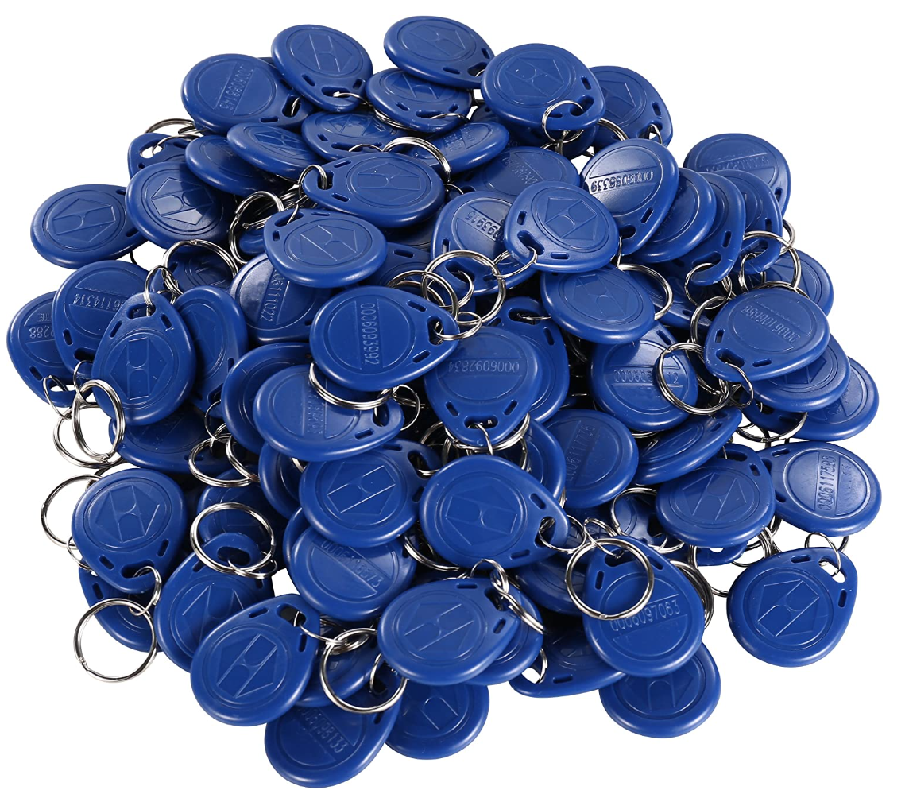
RFID Fob Cloning/Emulating
Threat Identifier | Threat #4
Threat Description | Attacker seeks to clone fob or use fob emulator for building access
Threat Target | User, building security
Risk Assessment | Medium
Attack Techniques | Use of cloned fob, emulator
Countermeasures | Limit fob access to authorized users only

Slide 20
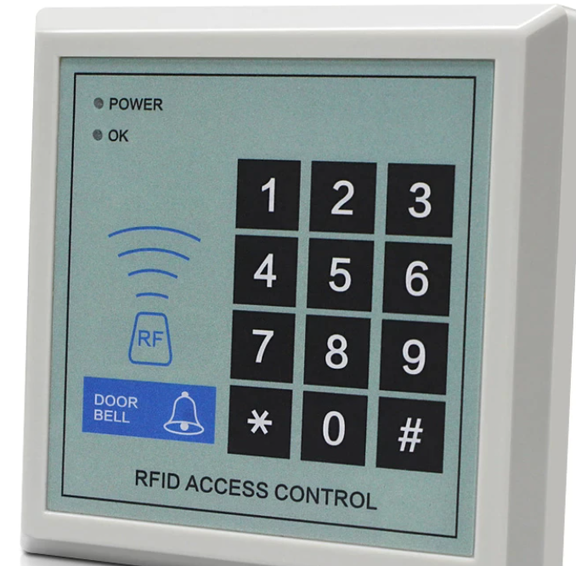
Manipulate Keypad Access
Threat Identifier | Threat #5
Threat Description | Attacker seeks to manipulate for keypad and building access
Threat Target | User, building security
Risk Assessment | Medium
Attack Techniques | Hacking
Countermeasures | Limit authorized access

Slide 21

Password Guessing
Threat Identifier | Threat #6
Threat Description | Attacker seeks to guess password for building access
Threat Target | User, building security
Risk Assessment | High
Attack Techniques | Hacking
Countermeasures | Change password every 90 days

Slide 22
Power Supply
Threat Identifier | Threat #7
Threat Description | Attacker seeks to cut the power supply from the system for building access
Threat Target | Building security
Risk Assessment | High
Attack Techniques | Hacking
Countermeasures | External Protection for Power Supply

Slide 23
Risks
Assess risks of system threats and vulnerabilities
Risk in identification security of access control system
Risk in structural security of access control system
Risk in data transmission security of access control system
Risk in data storage security of access control system
Risks developed into Risk Registration and Risk Matrix

Slide 24
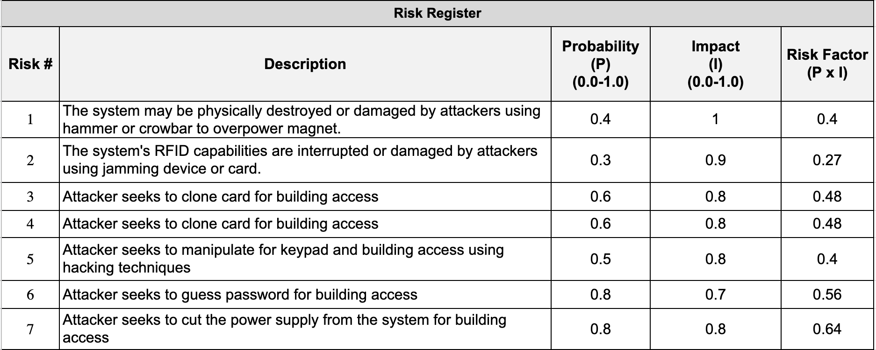
Risk Register

Slide 25
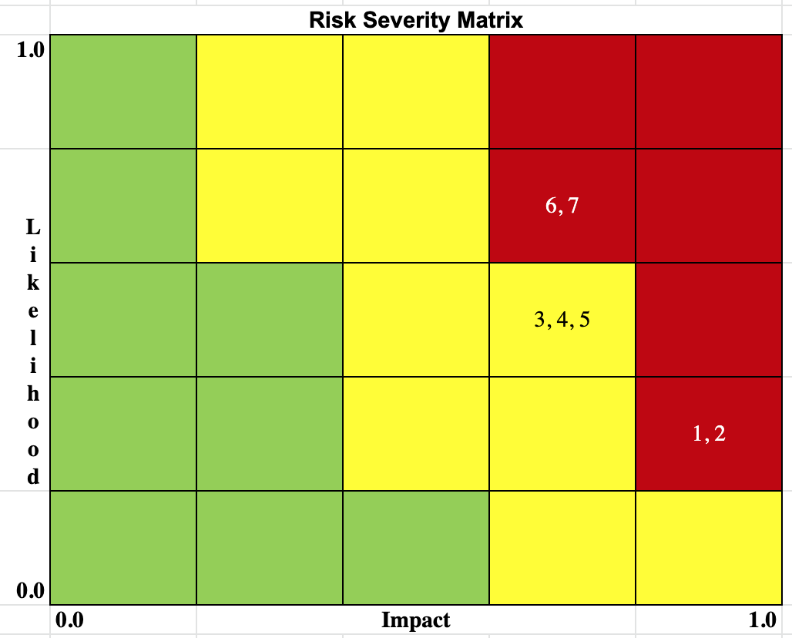
Risk Matrix

Slide 26
Attack Trees

Slide 27
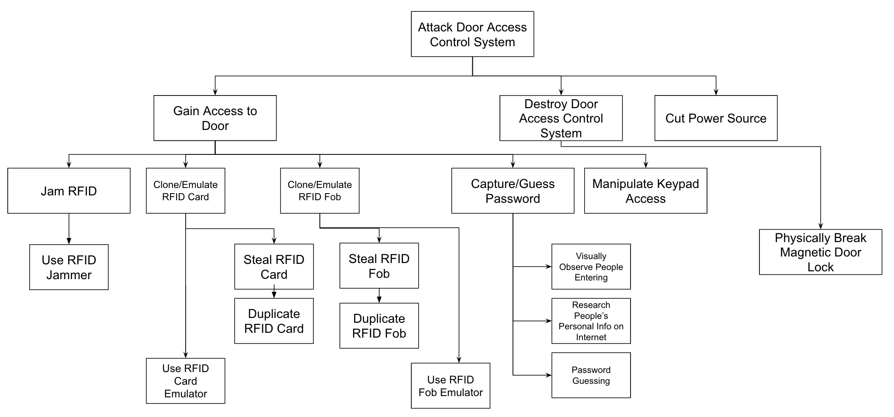
Attack Tree

Slide 28
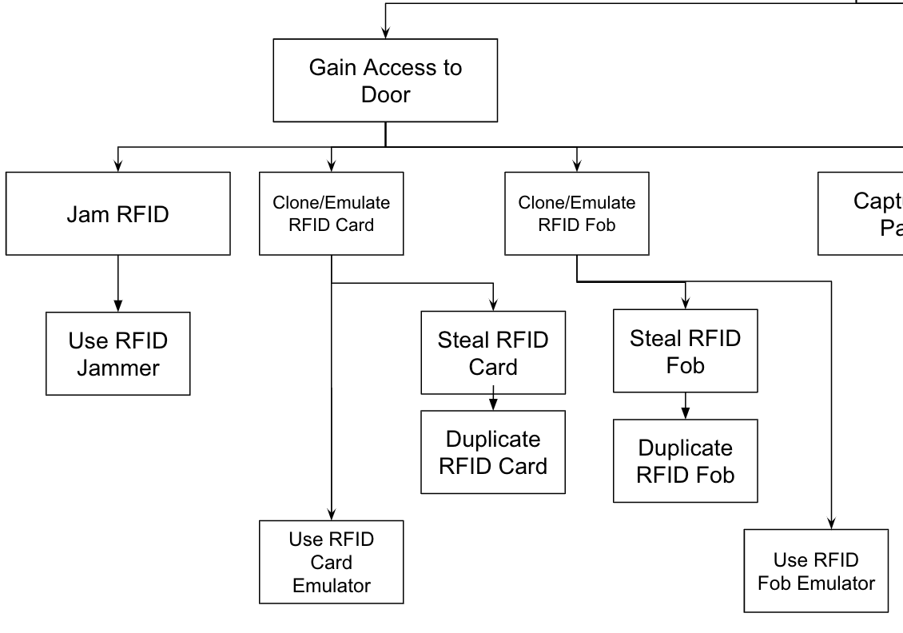
Gain Access to Door
Jam RFID
Use of jamming device
Destroy/interrupt RFID capabilities
Clone/Emulate RFID Card
Steal RFID card and duplicate
Use RFID card emulator
Devices available for sale online
Clone/Emulate RFID Fob
Steal RFID fob and duplicate
Use RFID fob emulator
Devices available for sale online

Slide 29
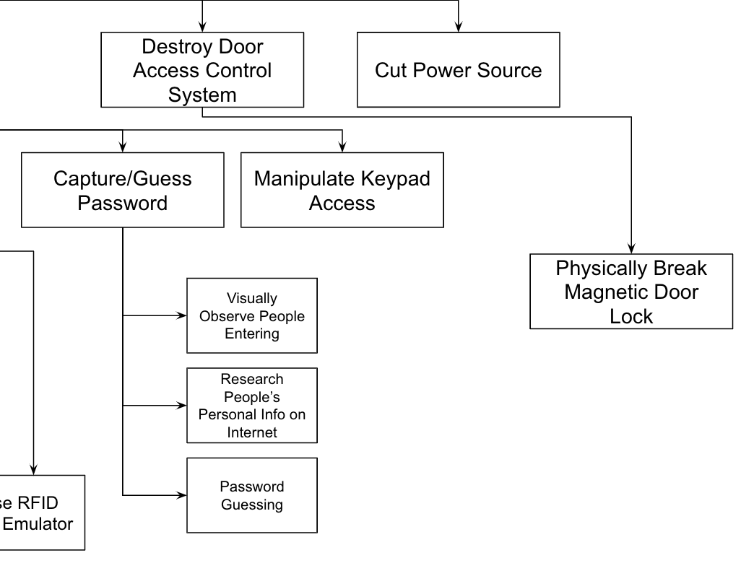
Gain Access to Door - cont.
Capture/Guess Password
Visually observe people entering
Research people’s personal info on internet
Password guessing
Password length limited
Manipulate Keypad Access

Slide 30
Destroy Control Access System, Cut Power Source
Destroy door access control system
Physically break magnetic door lock
Force Magnetic Lock Open
Cut power source

Slide 31
Security Controls

Slide 32
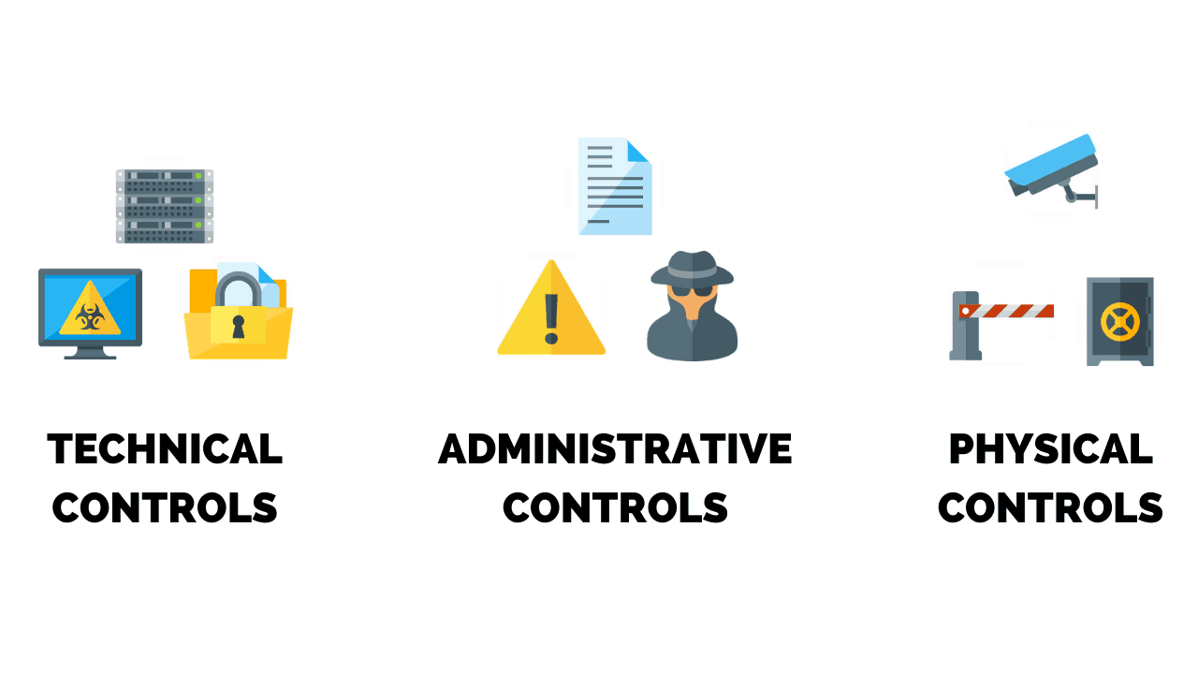
Summary
60Kg/120LB Locking force
Ability to change administrator passcode and user passcode
3-digit, unique serial number for each card

Slide 33
60Kg/120LB Locking Force
Physical Control
Low threshold
Security Vulnerability

Slide 34
Ability to change administrator passcode and user passcode
Administrative Control
Prevents people with access to default passcode to use the system
Depends on administrator to be aware of the vulnerability

Slide 35
3-digit, unique serial number for each card
Technical Control
Makes it more difficult to create duplicate keys
Allows for the removal of lost or stolen keys

Slide 36
Additional Security Controls and Countermeasures

Slide 37
Summary
Higher locking force
Shield for card and fob
Switch for card
Embedded alarm system
Add camera system
Add backup battery system

Slide 38
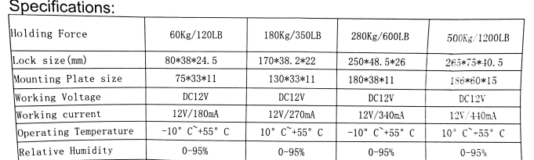
Higher Locking Force
Physical Control

Slide 39
Shield for Card and Fob
Physical Control
Physical shield that surrounds card and fob
Prevents from being read

Slide 40
Switch for Card
Technical Control
Tag is only readable with switch activated
Prevents hijackers from reading cards or extending card signal

Slide 41
Embedded Alarm System
Technical Control
In the case of break in
Notify the owners
Notify the authorities

Slide 42
Camera System
Physical Control
Add visual protection to the system

Slide 43
Backup Battery System
Physical Control
When power supply is cut
Add backup battery system that helps in case of power interruptions

Slide 44
Adjusted Risk Assessment

Slide 45
Adjusted Risk
Added security controls and measurements will help address and mitigate risks
Most risks are low now
Medium risks
Attacker guesses password, gains access
Even with cameras, attacker could still have disguise or pass as someone with authorized access.
Can do damage before authorities arrive
Power supply cut-off
Do further testing of backup battery capabilities

Slide 46
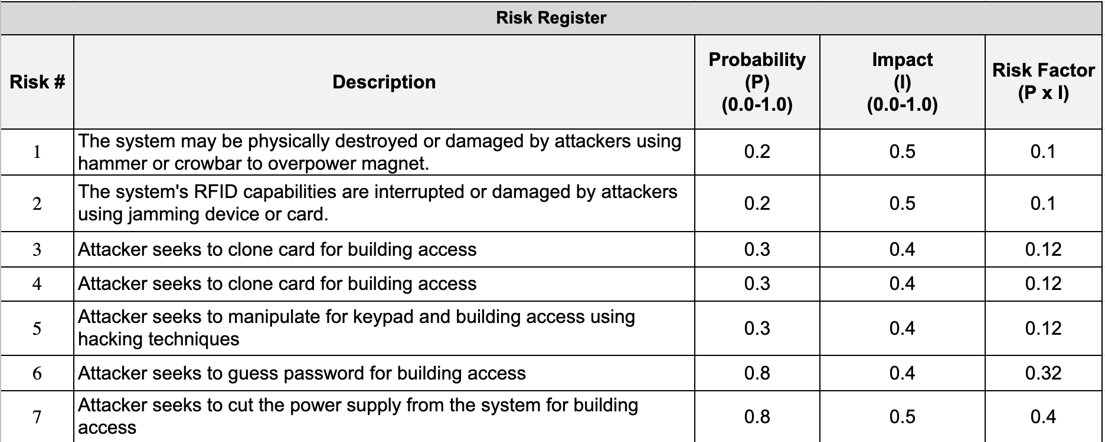
Risk Register

Slide 47
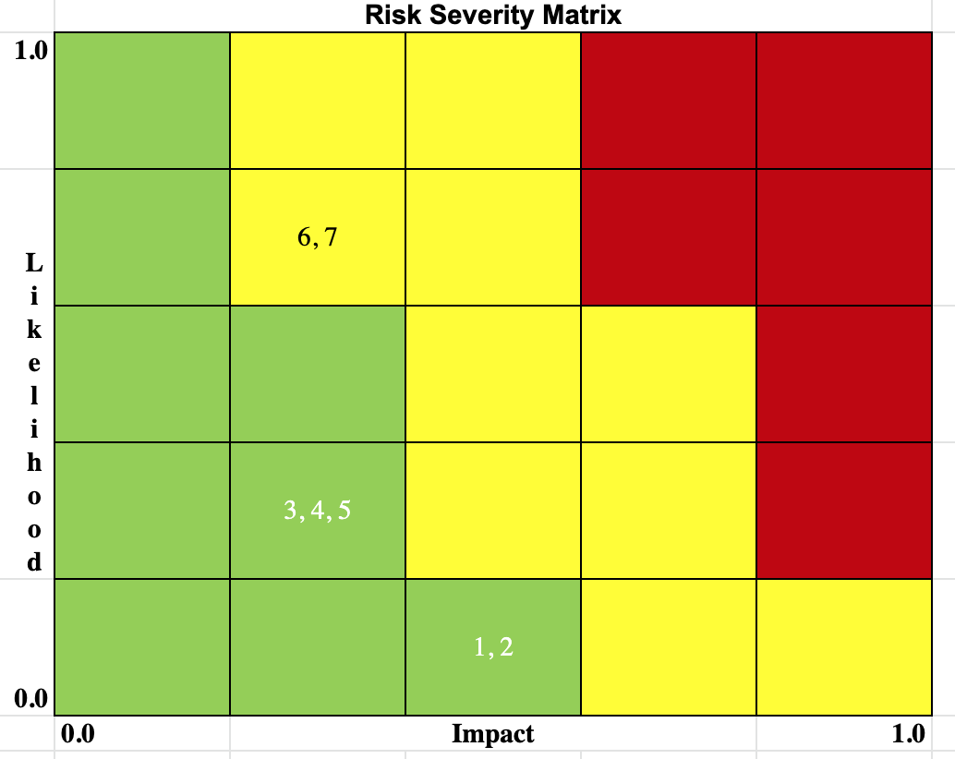
Risk Matrix

Slide 48
Recommended Security Requirements

Slide 49

Summary
Lock size of at least 170*38.2*22 (mm) Mounting plate size of at least 130*33*11 (mm)
Embedded Alarm System
Switch or Shield for Card

Slide 50

Lock Size
Lock size of at least 170*38.2*22 (mm) Mounting plate size of at least 130*33*11 (mm)
This creates a holding force of 180Kg/350lbs, this is 3x greater than the current holding force and the average person would have difficulties breaking in.

Slide 51

Embedded Alarm System
In the case of physical attack, the owners of the system will be made aware

Slide 52
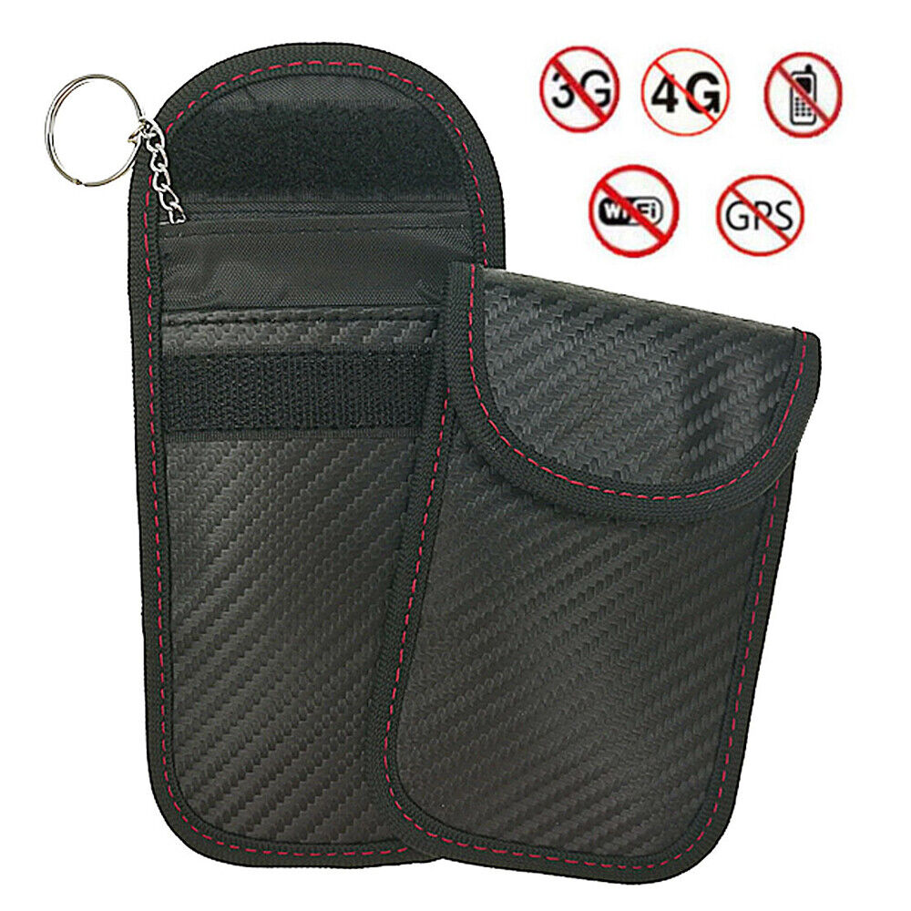
Switch or Shield for Card
Switch on card that when pressed, allows the card to be read
Shield for card that prevents the card from being read while it is on
Both offer the same security when it comes to preventing a card’s signal from being read or extended

Slide 53

Camera System
Current camera system allows possible connection to other terminals
Opportunity for reinforced security with camera system
Visual protection for a live feed with storage for recording

Slide 54

Backup Battery/Power Supply
Even when hackers can cut power supply, the system needs to function with that type of interruption
Addition of backup battery for sustained power supply in the case of an attack

Slide 55
Summary

Slide 56
Summary
VULNERABILITIES
AGPTEK RFID Scanner
Vulnerable to physical attacks
Cards and fobs are vulnerable to being read
Power supply is vulnerable to attacker (no power means the lock is off)
POTENTIAL SOLUTIONS
Lock size of at least 170*38.2*22 (mm) Mounting plate size of at least 130*33*11 (mm)
Embedded Alarm System
Switch or Shield for Card
Protection of power supply relies on user
Addition of cameras
Addition of backup battery/power supply

Slide 57
Questions?

Slide 58
References
https://www.amazon.com/dp/B00IDVNAT6/ref=emc_bcc_2_i

